Slide 1
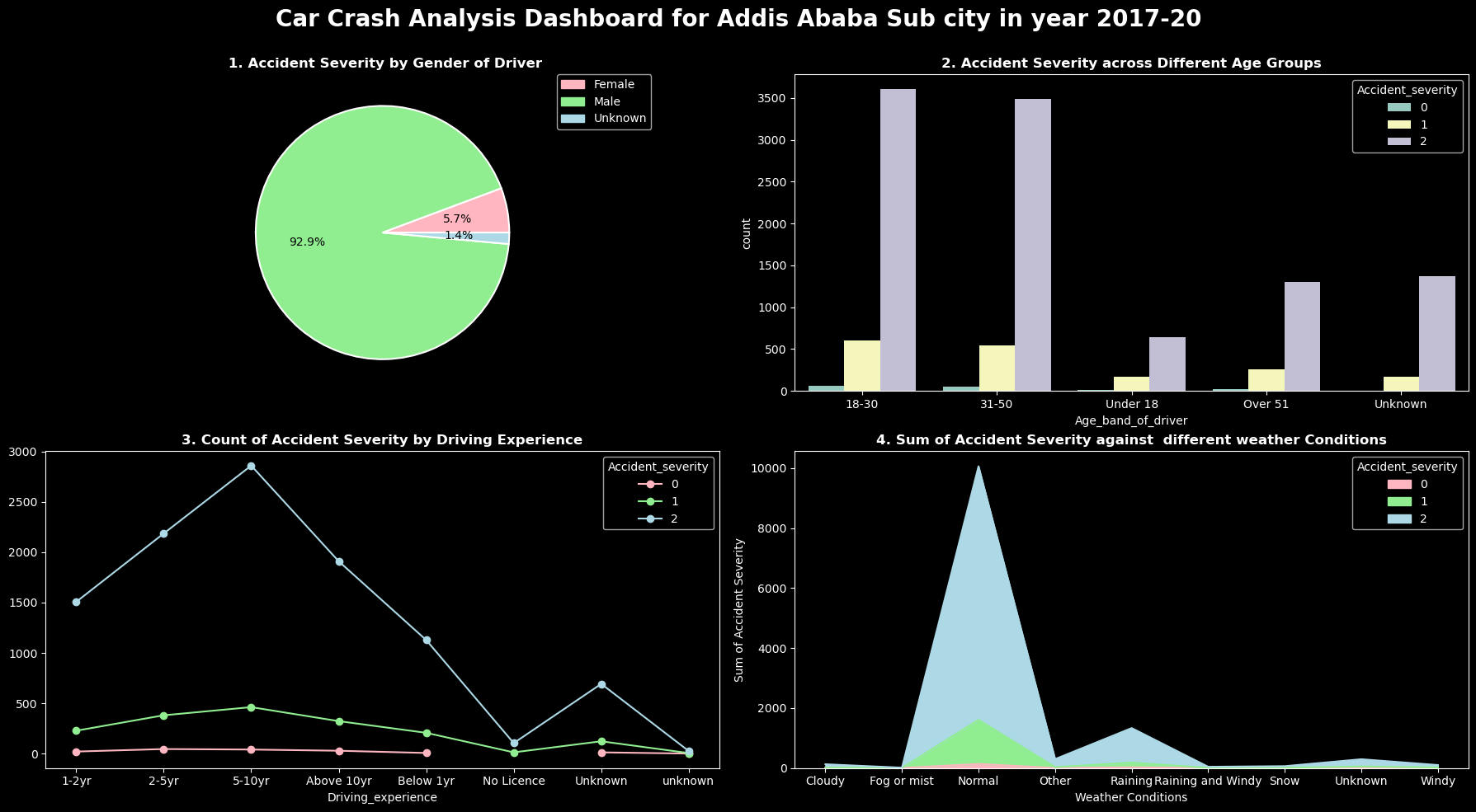
Name: Vasanth Kumar Mekala
Student Id: 22058159
Description:
This infographic provides a comprehensive understanding of various factors contributing to car accidents. By examining accident severity concerning sex, age, education and other attributes, we gained insights crucial for road safety interventions and policy implementations.
The pie chart indicates the 92.9% males were affected by car crash incidents.
The bar chart indicates . that the most accidents were in the 31-50 age group, followed by the 18-30 age group.
The line chart shows the ones who had experience of 5-10 years had more severe car crash followed by 2-5 years of experience.
The stack area chart represents that most accidents occurred in normal weather followed by the rainy weather conditions.
These visualizations, when analyzed collectively, creates a narrative about the correlation between different attributes as observed.
Source: (Abdallahabouelabbas, 2022)

